Slide 1
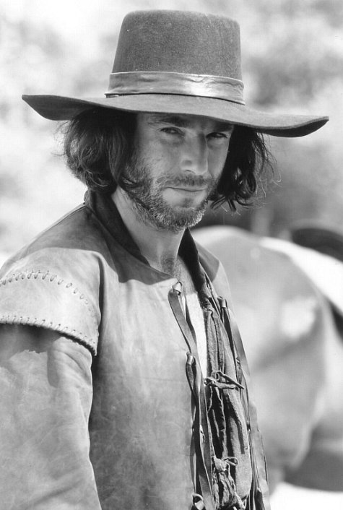
Tragic Hero
John Proctor

Slide 2
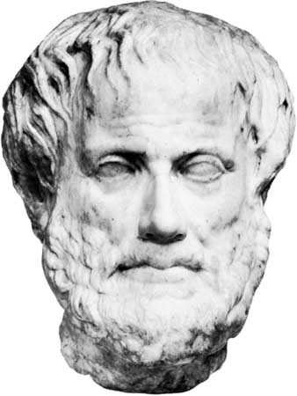
According to Aristotle…
In literature, “Tragedy… is an imitation of an action that is serious, complete, and of a certain magnitude; with incidents arousing pity and fear, wherewith to accomplish its catharsis of such emotions.” In other words, to be a true tragedy, a play must make the audience pity the characters and make them fear the same consequences the character (usually the protagonist) experiences.

Slide 3
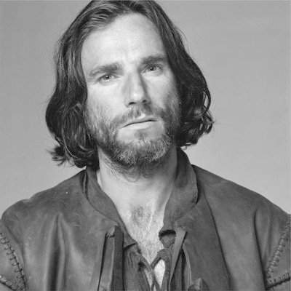
Aristotle’s Tragic Hero
A tragic hero is a protagonist with a fatal ,or tragic, flaw which eventually leads to his downfall.
The Aristotelian tragic hero is introduced as happy, powerful, and privileged, and ends up dying or suffering immensely because of his own actions or mistakes.
The tragic hero must have four characteristics: -goodness (a moral and ethical person) -superiority (someone with supreme or noble authority/control), -tragic flaw (will eventually lead to his own demise), -the eventual realization that his decisions or actions have cause his downfall (faces death or suffering with honor).
Usually the realization of the tragic flaw results in an epiphany, or a sudden realization by the character, audience, or both, and a catharsis, or a release of emotions, which makes the audience feel more at peace.

Slide 4
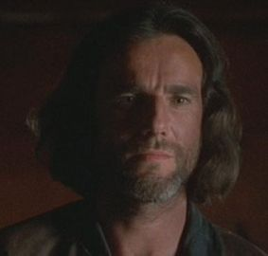
1. In your opinion, what is John Proctor’s tragic or fatal flaw?

Slide 5
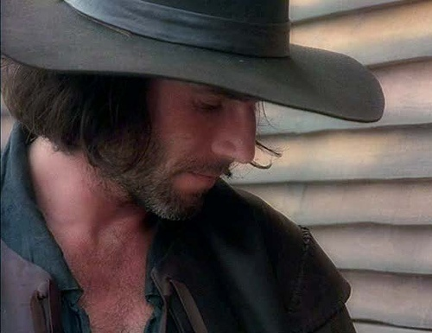
2. When Proctor is first introduced, is he “happy”? Why or why not?

Slide 6
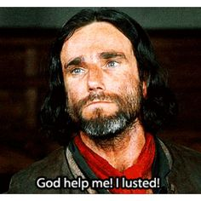
3. How might Proctor be considered a superior or privileged person?

Slide 7
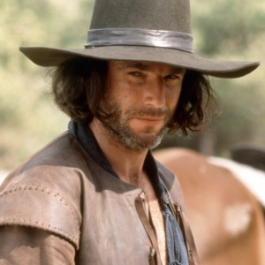
4. In your opinion, is Proctor a moral and/or ethical person?

Slide 8
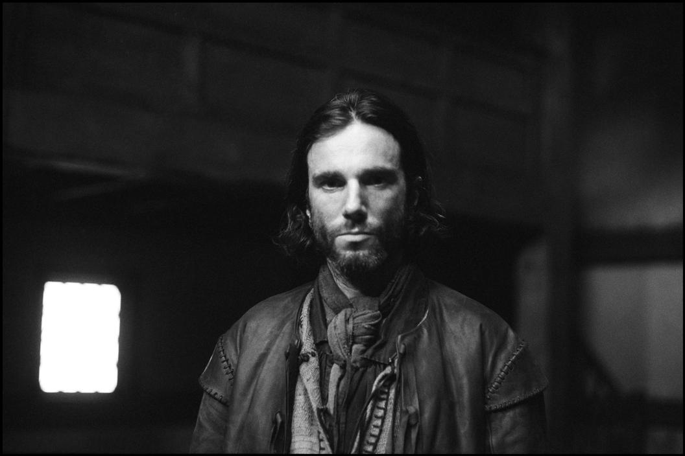
5. At what point does Proctor realize he is facing his own demise? What is his reaction? How is/isn’t this consistent with the characteristics of the tragic hero?

Slide 9
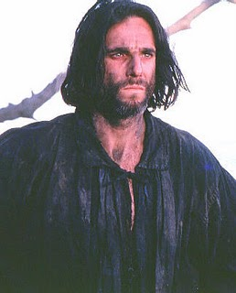
6. Do you feel John Proctor is the ideal tragic hero? Why or why not? Explain how he fits or does not fit the definition of a tragic hero.

Slide 10
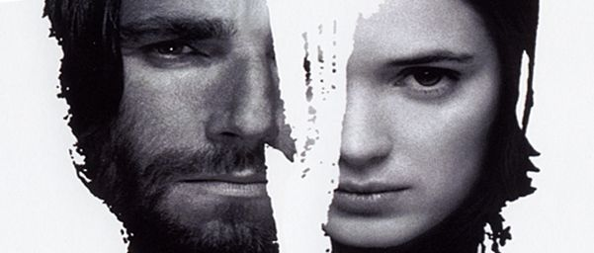
7. According to the definition, is The Crucible a tragedy? Do you feel pity for the characters, especially John Proctor? Did you experience catharsis even though you did not suffer the same fate as John and the others who were accused of practicing witchcraft?

