Slide 1
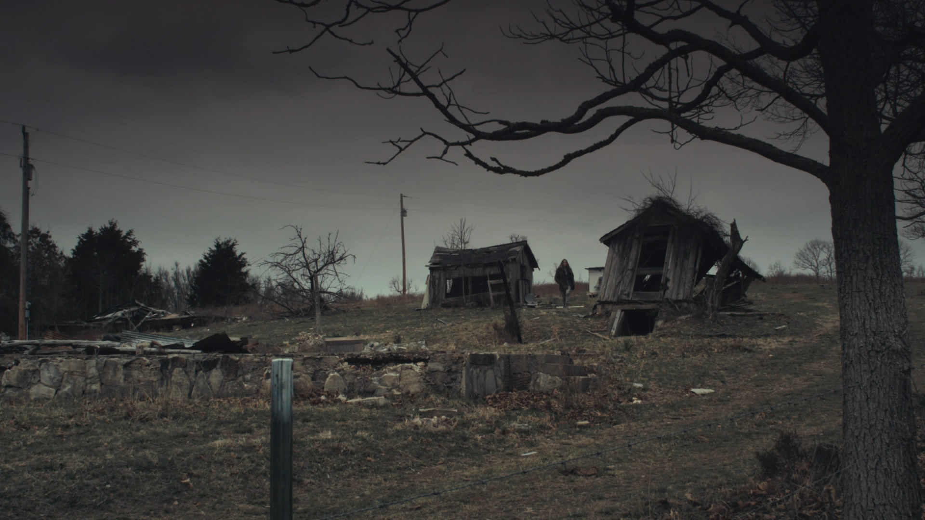
Southern Gothic Literature
A Subgenre of Gothicism
Adapted from www.digitalcommons.trinity.edu

Slide 2
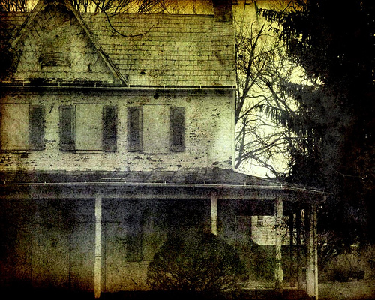
What is it?
Southern Gothic is the name given to an American literary movement with its roots in the Romantic and Gothic traditions of British literature. Authors that write in the Southern Gothic style borrowed the hyperaware, emotionally rich style of the Romantics and the Gothic interest in isolation and decay and applied these ideas to their region of the United States to develop a unique literary style.

Slide 3
C h a r a c t e r i s t i c s you might find: -isolation and marginalization -violence and crime -sense of place -freakishness and the grotesque -destitution and decay -sadness and loss -heavy use of symbolism and suggestion

Slide 4
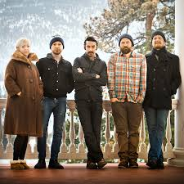
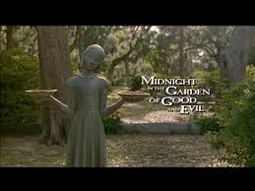
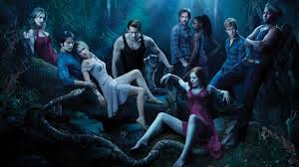
Additionally these thematic concerns have made their way into music, TV, and film (some of which are adaptations of author’s work). These include movies like Midnight in the Garden of Good and Evil, TV shows like True Blood, American Horror Story, and The Vampire Diaries. Bands like Murder by Death have even introduced Southern Gothic themes into their music both in terms of style and subject matter.
My high school friend David!

Slide 5
It is common in Southern Gothic literature, to find innocence surrounded by cruelty and corruption. When southern gothic authors examine the human condition, they see the potential to do harm. Morality is in question for many characters. A major theme for southern gothic writers hinges on innocence and the innocent’s place in the world— where they are often asked to act as redeemer. However, through the lens of these authors the question often becomes can this corrupt, tainted world even be saved? Can innocence be victorious? Conclusions vary according to author.

