Slide 2
E.O.C. Preparation INFORMATION and Practice Test Review

Slide 3
TESTING SCHEDULE
SECTION I (90 minutes):
MONDAY, APRIL 23
3rd period
10:24 – 12:23 (during 3-4 periods)
G 125
TUESDAY, APRIL 24
2nd period
8:20 – 10:18 (during 1-2 periods)
E 102
SECTION II – III (75 miuntes each):
WEDNESDAY, APRIL 25
3rd period
12:29 – 3:30 (during 5-7 periods)
G 125
THURSDAY, APRIL 26
2nd period
8:20 – 11:21 (during 1-3 periods)
G 125

Slide 4
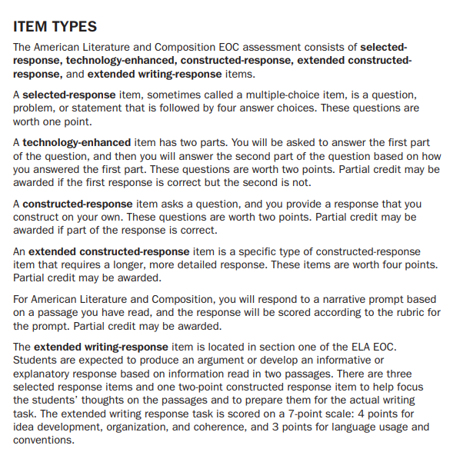
(Multiple choice)
(No idea why it’s
called this)
(Short answer—couple of sentences)
(Longer answer—likely,
a paragraph)
(Essay: Intro (with thesis), body, conclusion)

Slide 5
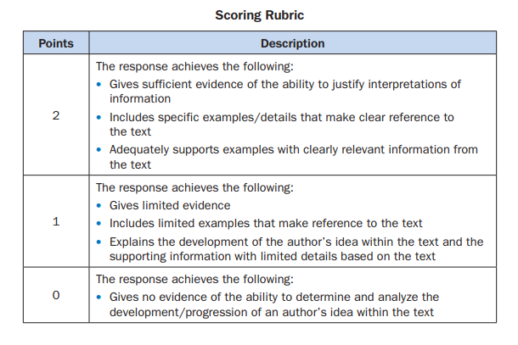
CONSTRUCTED RESPONSE (2 points)

Slide 6
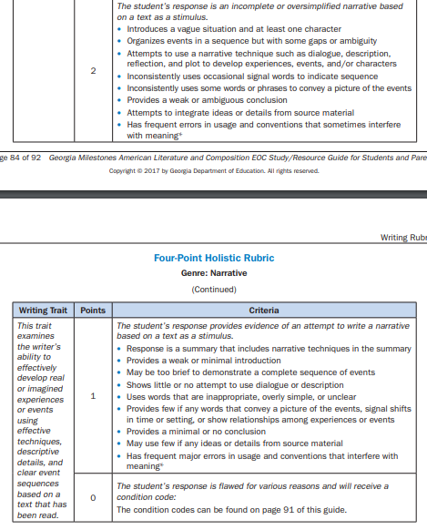
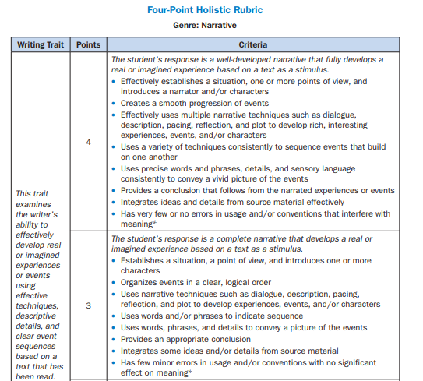
EXTENDED CONSTRUCTED RESPONSE (4 points)

Slide 7
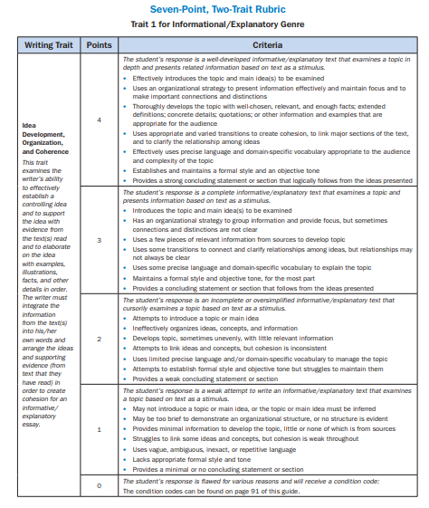
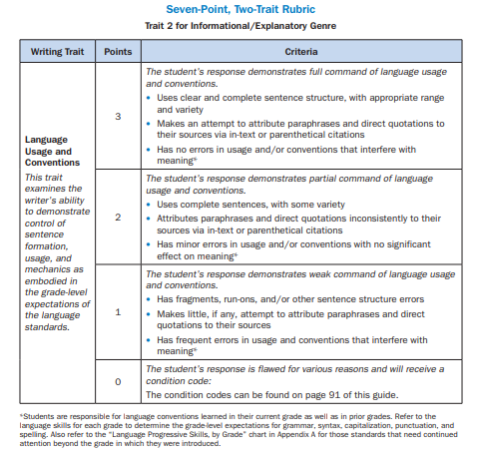
EXTENDED WRITING RESPONSE (7 points)

Slide 9
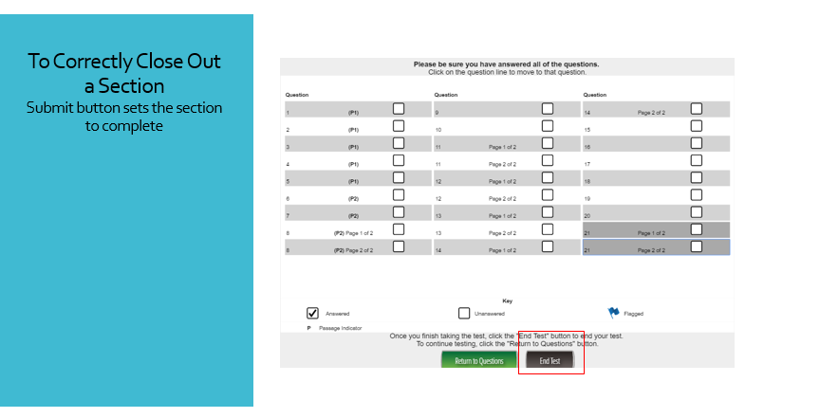

Slide 11
Now, let’s go over the practice test…

Slide 12
1. D
2. A
3. D
4. C / D
5. Constructed Response – Use rubric to self-assess
6. C
7. A
8. A
9. Constructed Response – Use rubric to self-assess
10. Extended Constructed Response—Use rubric to self-assess
11. B
12. A
13. Constructed Response – Use rubric to self-assess
14. Extended Writing Response—Use rubric to self-assess
15. A
16. C
17. Constructed Response
PRACTICE TEST ANSWERS

